Slide 1





DBMS Lab Miniproject
Hire-Me
A Recruitement Management System
By
Twishaa Sahay (RA1911003010068)
Aryaman Rana (RA1911003010078)
Soumyadeep Pal (RA1911003010084)

Slide 2

Objective
To make database management system which can be use for creating and applying jobs by recruiters and clients .
Next

Slide 3

Introduction
A Social Enterprise - Bridging the gap between students and Corporates.
Hire-Me is an Platform providing freshers jobs- linking corporate, students and colleges and forms a link between recruiters and clients who are in search for job.
02
Next

Slide 4


OUR PROJECT HIRE-ME IS A RECRUITEMENT DATABASE MANAGEMENT SYSTEM WHICH CAN BE USE FOR CREATING AND APPLYING JOBS .
What our Project Focuses on :
IT HAS A WELL ORGANISED INTERFACE AND SOME ONE CLICKABLE FUNCTIONALITIES.
03
Next

Slide 5

Tkinter
Tkinter is the standard GUI library for Python. Python when combined with Tkinter provides a fast and easy way to create GUI applications. Tkinter provides a powerful object-oriented interface to the Tk GUI toolkit.
Creating a GUI application using Tkinter is an easy task. All you need to do is perform the following steps −
Import the Tkinter module.
Create the GUI application main window.
Add one or more of the widgets to the GUI application.
Enter the main event loop to take action against each event triggered by the user.
04
Next

Slide 6

What are Features of our project
A 1050 x 700 gui window.
Register Panel
Client Login
Recruiter Login
Various Features
05
Next

Slide 7
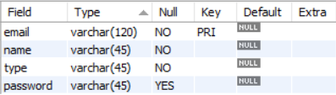
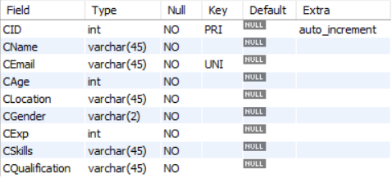
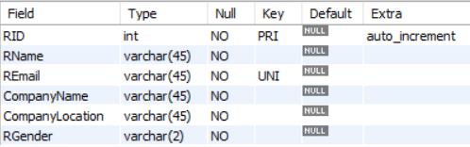
Schemas
Users
3. Client
2. Recruiter

Slide 8
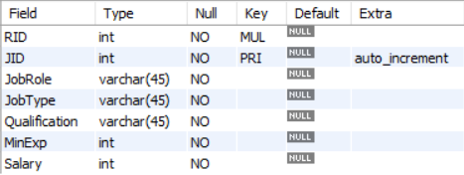
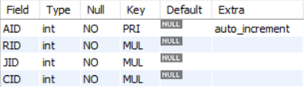
4. Job
5. Application

Slide 9
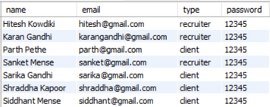
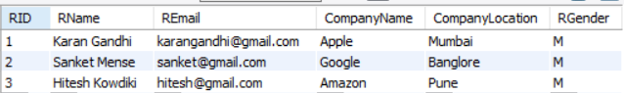
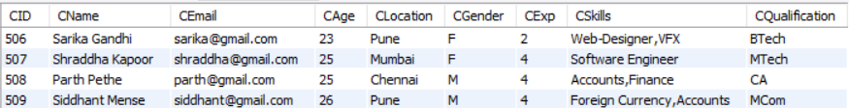
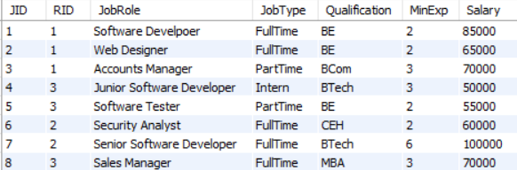
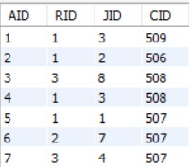
Workflow
Username-Passwords
Recruiter
Client
Jobs
Applications
08
Next

Slide 10
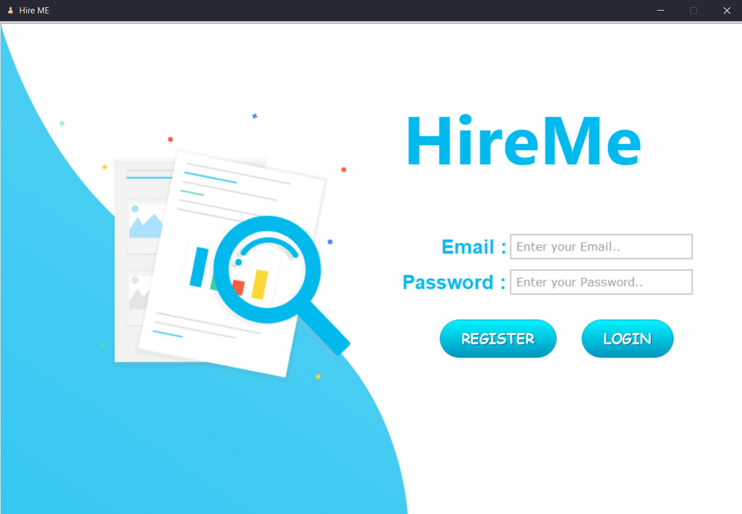
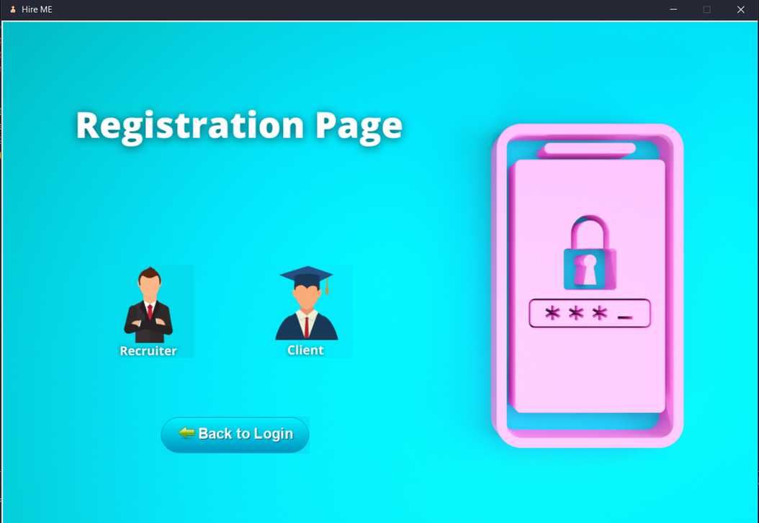
ScreenShots
Main Screen
Registration Page

Slide 11
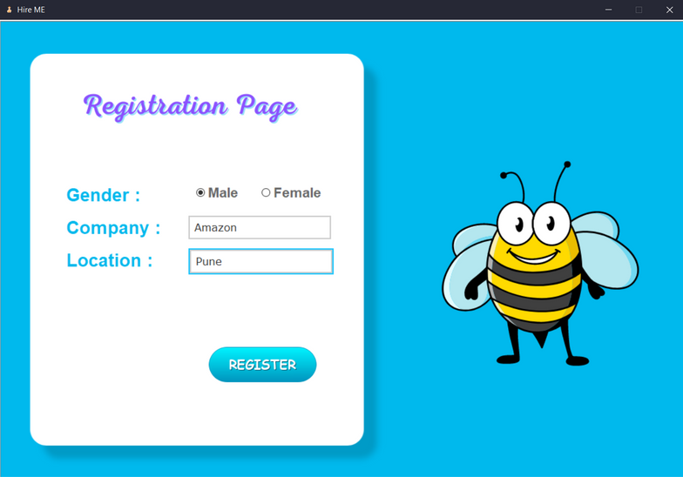
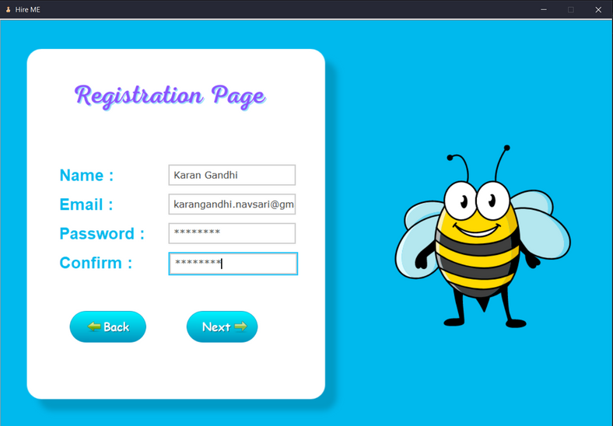
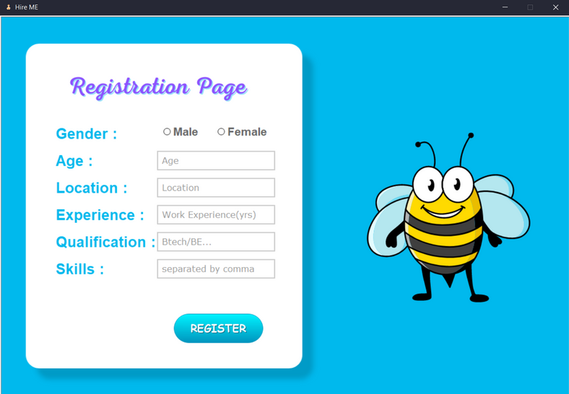
Recruiter
Client

Slide 12

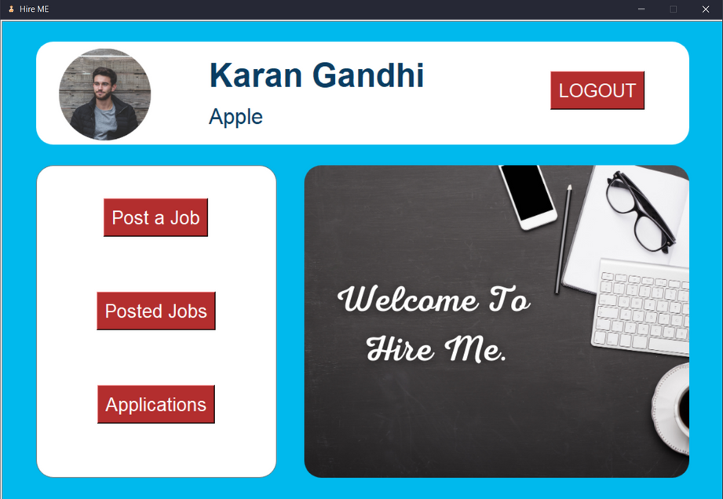
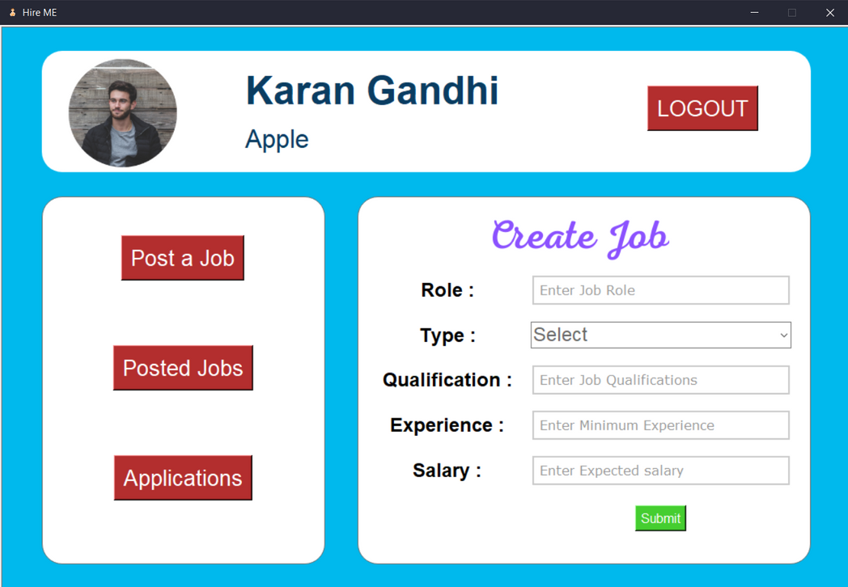
Recruiter
Post a Job
Recruiter Main
Screen

Slide 13
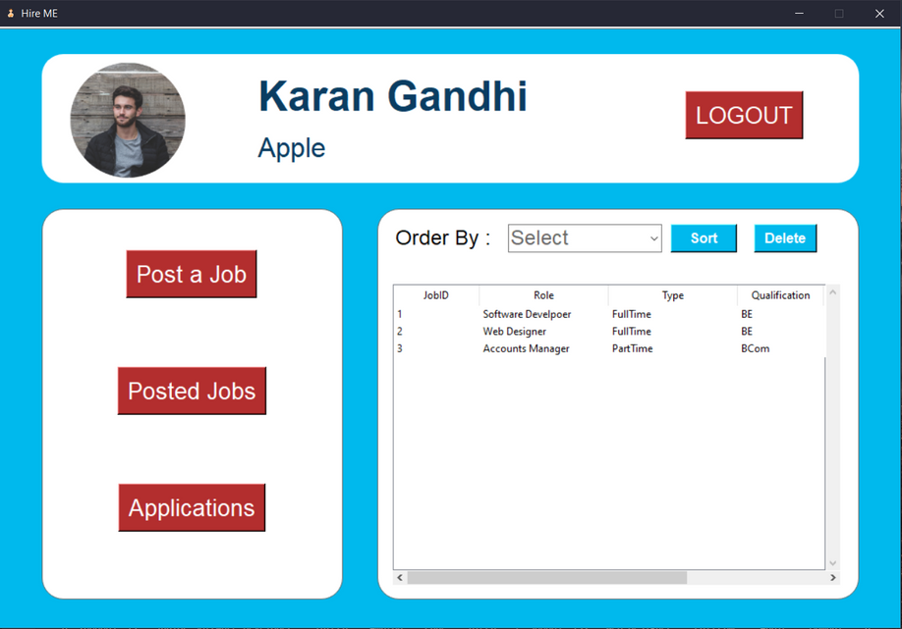
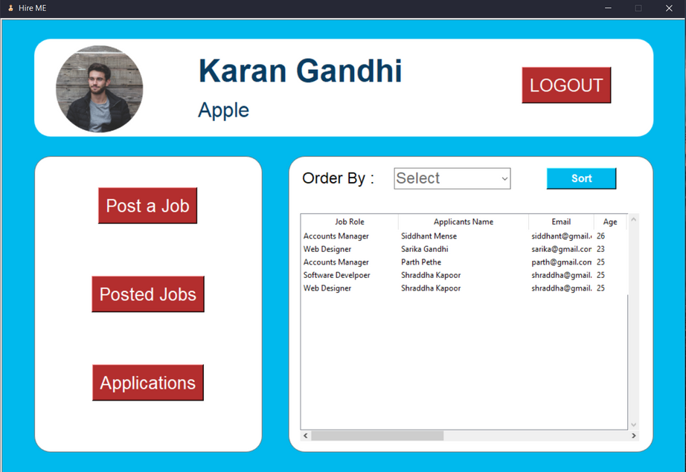
Applications
Posted
Jobs

Slide 14
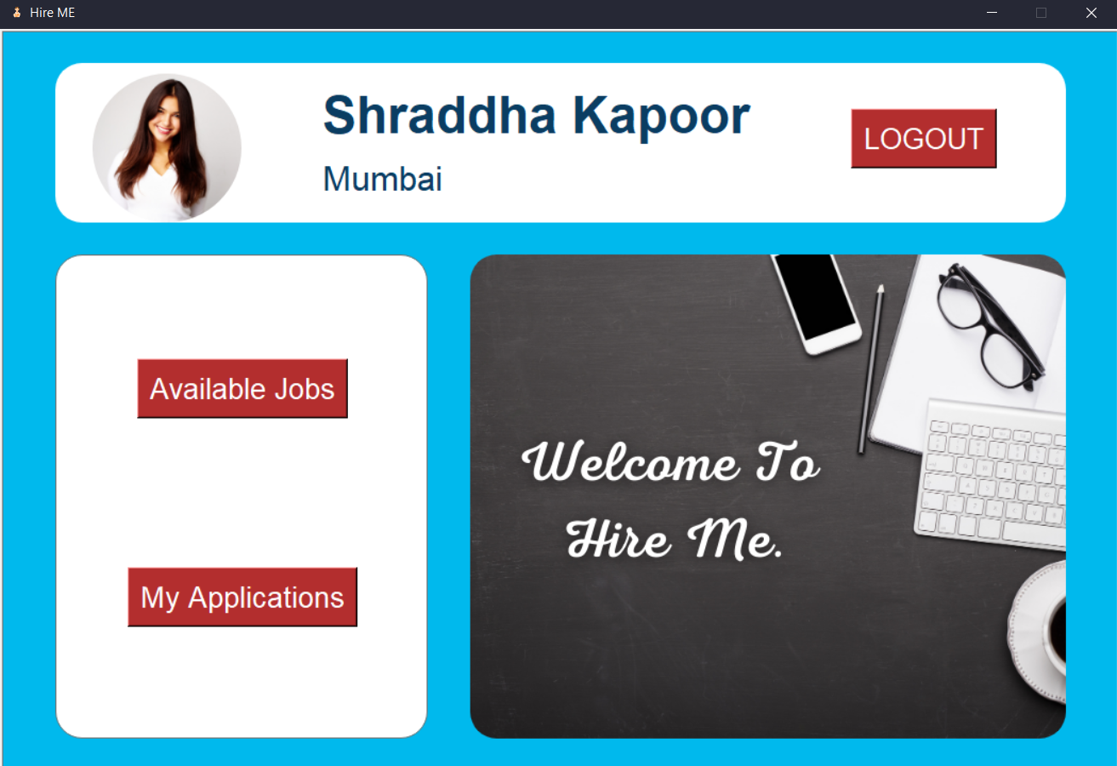
Client
Client Main Screen

Slide 15
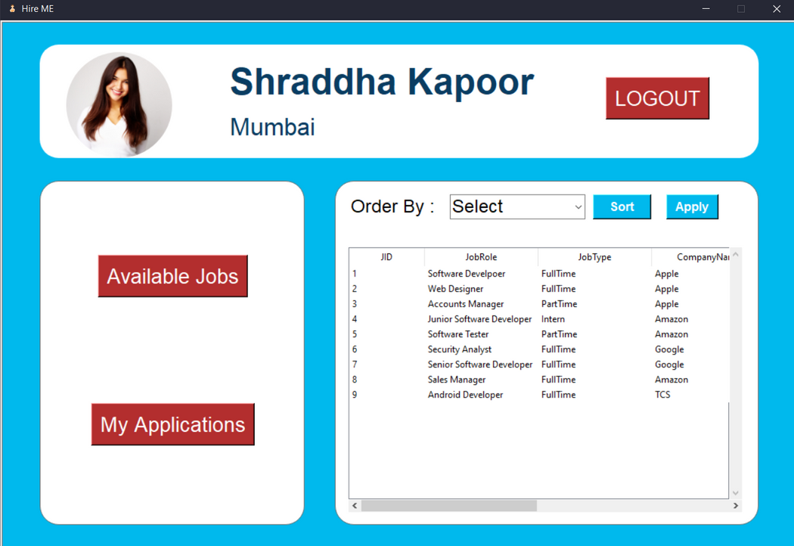
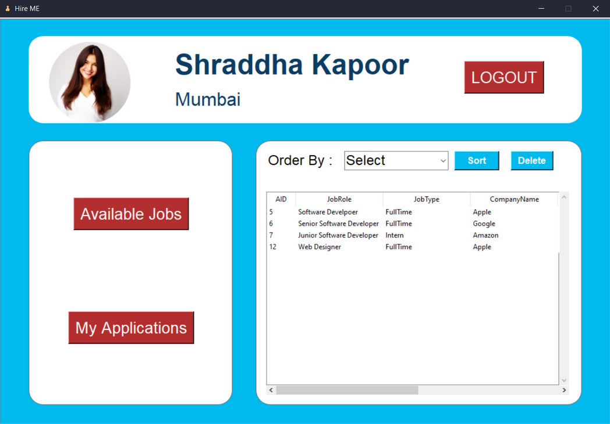
My Applications
Available
Jobs

Slide 16

S/w and H/w Requirements
Laptop / PC having windows 7 or higher/Linux/MacOS
Minimum i3 processor and 500 mb space
Python Environment , Tkinter
Database MySQL
09
Next

Slide 17

Advantages
It is very useful for the clients as well as Recruiter to connect easily and free to search jobs anytime.
Simple UI and one click functionalities
Disadvantages
The only disadvantage at this moment is it requires python and some dependencies as it is GUI based but can be overlooked in future
10
Next

Slide 18

Future Scope
More Features can be added like we can make Resume on it and can share to nearby recruiters.
It can be implemented on web platform and hosted on web so it can be accessed from any device.
Super-User Panel For Future Features.
11
Next

Slide 19


Quote
It's the journey rather than the destination,
which makes the travel interesting.

Slide 20

Presented By:
Karan Gandhi
Hitesh Kowdiki
Sanket Mense

